Slide 1
Comparative analysis: U.S. Craft Beers
Notes:
Hello Mr. Michel Doukeris, thank you for taking time out of your schedule to learn about our study with the data you provided. There were 2,410 beers across 558 US breweries that were analyzed in the study.

Slide 2
Breweries by State
States with highest number of breweries
Colorado - 47
California - 39
Michigan - 32
Oregon - 29
States with the lowest number of breweries
West Virginia - 1
South Dakota - 1
North Dakota - 1
Washington D.C. - 1
Notes:
The states with a lower number of breweries appear to be more related to being geographically based in more rural states

Slide 3
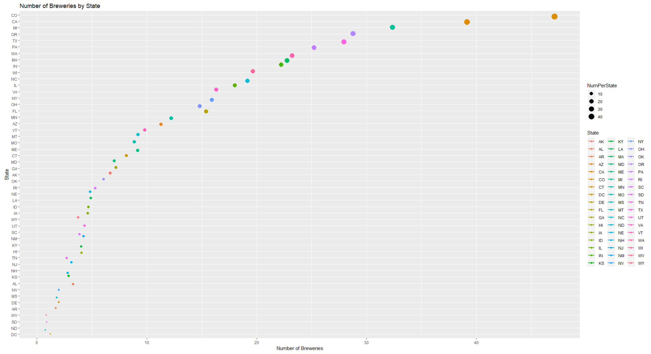

Slide 4
Top and Bottom Brewery and Beer
Top 6
Brewery Name | City | State | Beer Name | ABV | IBU | Style | Ounces
NorthGate Brewing | Minneapolis | MN | Pumpion | 0.06 | 38 | Pumpkin Ale | 16
NorthGate Brewing | Minneapolis | MN | Stronghold | 0.06 | 25 | American Porter | 16
NorthGate Brewing | Minneapolis | MN | Parapet ESB | 0.056 | 47 | Extra Special / Strong Bitter (ESB) | 16
NorthGate Brewing | Minneapolis | MN | Get Together | 0.045 | 50 | American IPA | 16
NorthGate Brewing | Minneapolis | MN | Maggie's Leap | 0.049 | 26 | Milk / Sweet Stout | 16
NorthGate Brewing | Minneapolis | MN | Wall's End | 0.048 | 19 | English Brown Ale | 16
Bottom 6
Brewery Name | City | State | Beer Name | ABV | IBU | Style | Ounces
Ukiah Brewing | Ukiah | CA | Pilsner Ukiah | 0.055 | NA | German Pilsener | 12
Butternuts Beer and Ale Garrattsville | Garrattsville | NY | Porkslap Pale Ale | 0.043 | NA | Ameracan Pale Ale (APA) | 12
Butternuts Beer and Ale Garrattsville | Garrattsville | NY | Snapperhead IPA | 0.068 | NA | American IPA | 12
Butternuts Beer and Ale Garrattsville | Garrattsville | NY | Moo Thunder Stout | 0.049 | NA | Milk / Sweet Stout | 12
Butternuts Beer and Ale Garrattsville | Garrattsville | NY | Heinnieweisse Weissebier | 0.049 | NA | Hefeweizen | 12
Sleeping Lady Brewing Company | Anchorage | AK | Urban Wilderness Pale Ale | 0.049 | NA | English Pale Ale | 12

Slide 5
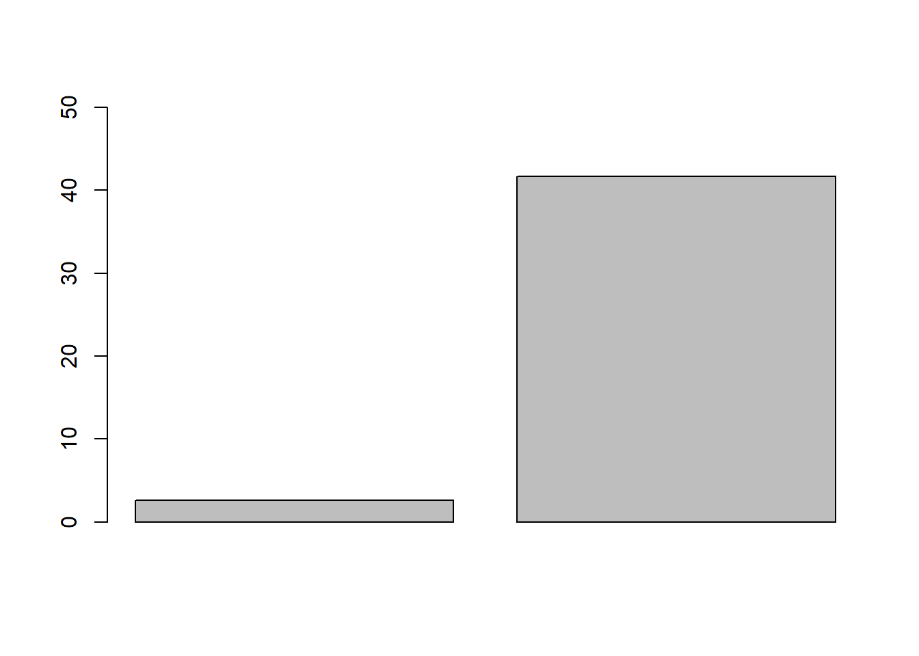
Report on NA values
The following percentages represent the NA values in the data set:
ABV: 2.6%
IBU: 41.7%
*These values are null values and not “Not Applicable” values
Notes:
We had to omit the beers with the NA values, but with the large amount of data provided, it did not impact the statistical analysis significantly

Slide 6
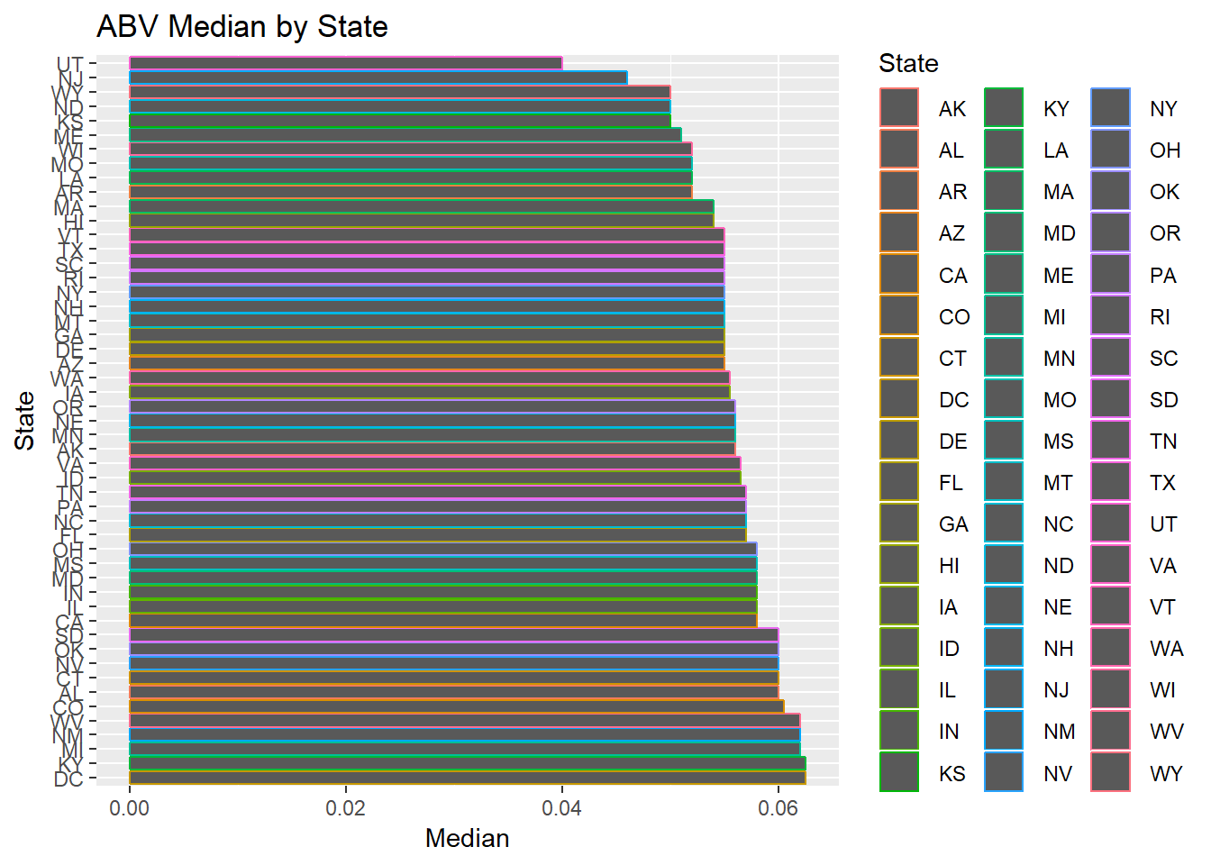
ABV Median by State
States with the highest alcoholic beer:
Kentucky and Washington DC
6.25% ABV
Notes:
Here we have a graphic of the median ABV by state

Slide 7
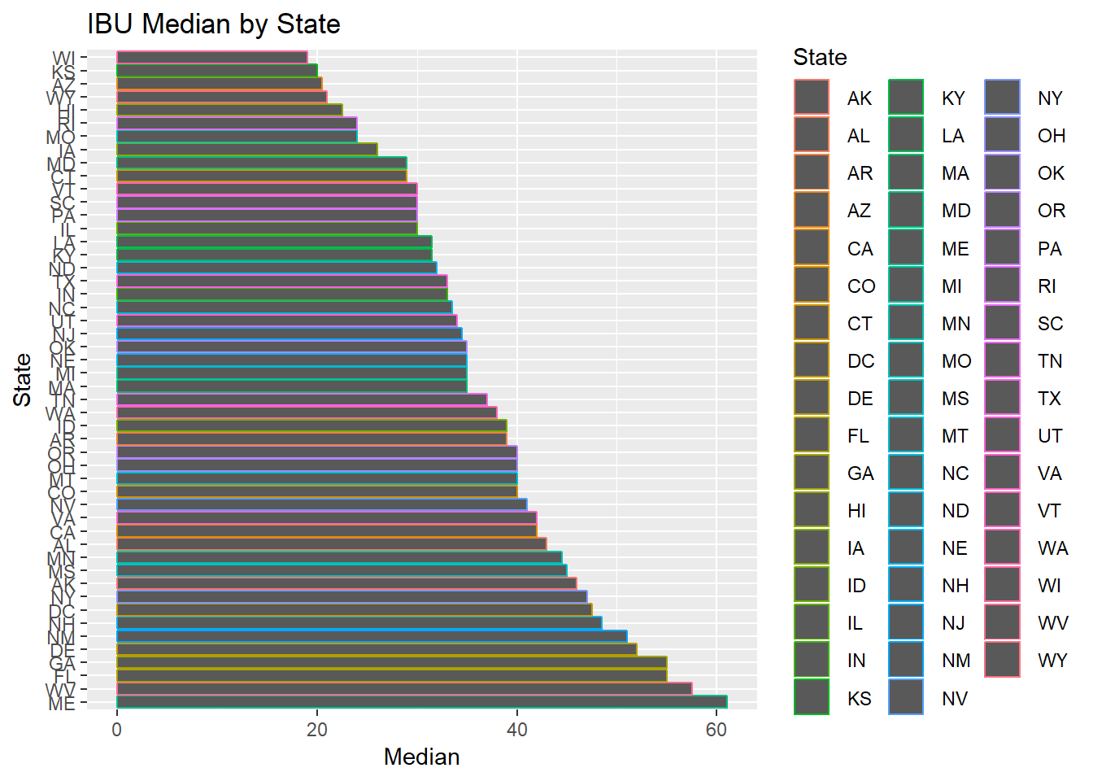
IBU Median by State
State that has the most bitter beer:
Maine
61 IBU

Slide 8
ABV and IBU summary
 | ABV | IBU
Mean | 5.98% | 42.71
Median | 6.7% | 35
Minimum | 0.01% | 4
Maximum | 12.8% | 138

Slide 9
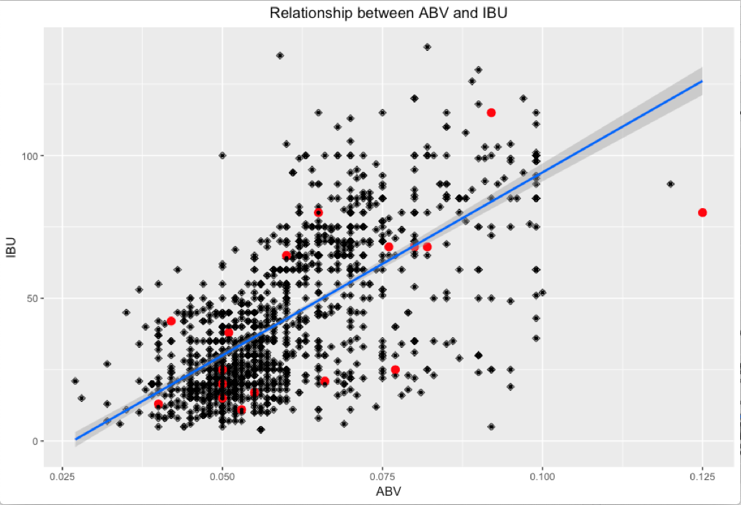
Relationship between abv and ibu
Notes:
The scatterplot shows a trend that increasing ABV in beer also increases the bitter taste. The red dots indicate beers from KY and DC

Slide 10

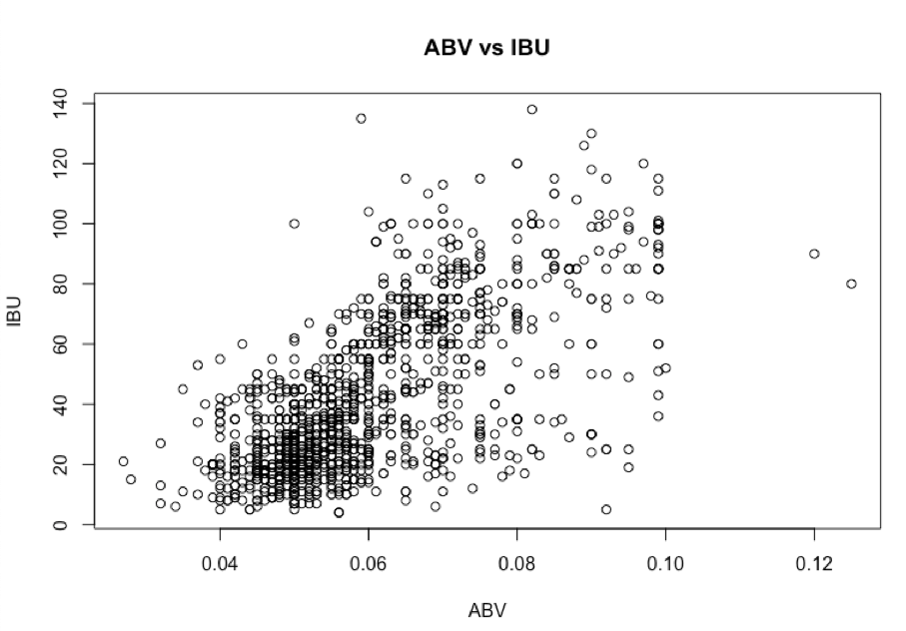
CORRELATION BETWEEN ABV AND IBU
p-value < 0.0001
Correlation coefficient = 0.67
Notes:
At an alpha level of 0.05 level of significance, there is significant evidence to suggest that the data are linearly correlated (p < 0.001)

Slide 11
Thank you
Any questions?

